Slide 1
ADVANCED VEHICLE SECURITY SYSTEM WITH THEFT CONTROL AND ACCIDENT NOTIFICATION USING GSM AND GPS TECHNOLOGY
PROJECT GUIDE:
MR.M.SAMBASIVA REDDY,
ASST.PROFESSOR.
TEAM MEMBERS:
M.SAIKRISHNA - 14761A0493,
A.SURESH BABU-14761A0461,
K.MOHANREDDY-14761A0482.

Slide 2
Contents
Introduction
Objective
Existing methods
Drawbacks of existing methods
Proposed method
Components and Description
Methodology
Results
Applications
Advantages
Conclusion
Future Scope
References

Slide 3
Introduction
As the accidents are occurring more due to certain conditons.There is a necessity to save the accident victims and security is the major requirement for a vehicle
There are existing methods of intimating the accident location
Here proposed a model of accident detection and theft control for the vehicle and tracking of vehicle and providing the security to the vehicle

Slide 4
Objective
To monitor the accident location and intimate the accident location through sums service
To provide security to vehicle
To track the location of vehicle
To control the vehicle from remote location

Slide 5
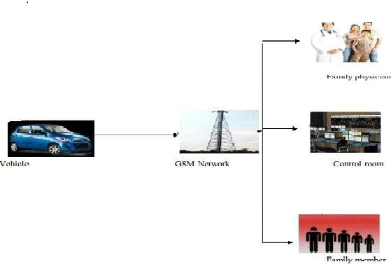
Existing Method
Wireless Black Box Tracking for Accidental Monitoring of Vehicles

Slide 6
Drawbacks in existing methods
There was security problem for vehicle
Controlling of vehicle from remote location wasn’t possible

Slide 7
Proposed Method
This system consists of ir sensors for providing security to the vehicle and also accident notification
The vehicle tracking and controlling of vehicle is done through a sms service

Slide 8
Components And Description
1.GPS module
2.GSM module
3.ATMEGA 89S52 microcontroller
4.Lcd display
5.Power supply
6.Vibration sensor, IR sensors
7.Motor

Slide 9
1.GPS
A GPS receiver calculates its position by precisely timing the signals sent by GPS satellite high above the Earth. Each satellite continually transmits messages that include
the time the message was transmitted
precise orbital information (the ephemeris)
the general system health and rough orbits of all GPS satellites (the almanac).

Slide 10
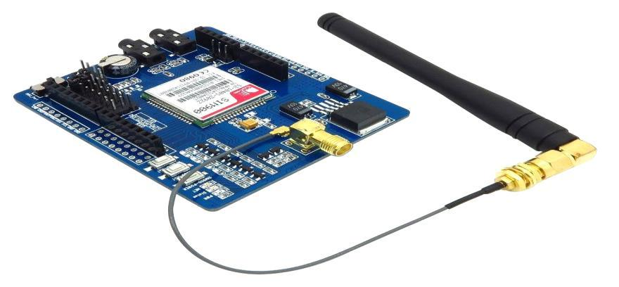
2.GSM
GSM (Global System for Mobile communications) is an open, digital cellular technology used for transmitting mobile voice and data services.
GSM (Global System for Mobile communication) is a digital mobile telephone system that is widely used in Europe and other parts of the world

Slide 11
3. ATMEGA 89S52 microcontroller
The AT89S52 is a low-power, high-performance CMOS 8-bit microcontroller with 4k bytes of Flash Programmable and erasable read only memory (EROM)
80C51 based architecture
4-Kbytes of on-chip Reprogrammable Flash Memory
128 x 8 RAM
Two 16-bit Timer/Counters
Full duplex serial channel
Boolean processor
Four 8-bit I/O ports, 32 I/O lines
Memory addressing capability
64K ROM and 64K RAM

Slide 12
4.LCD DISPLAY
A liquid crystal display (LCD) is a thin, flat display device made up of any number of color or monochrome pixels arrayed in front of a light source or reflector.
Some of the most common LCDs connected to the controllers are 16X1, 16x2 and 20x2 displays. This means 16 characters per line by 1 line 16 characters per line by 2 lines and 20 characters per line by 2 lines, respectively.

Slide 13
5.POWER SUPPLY
The power supply consists of
Transformer
Rectifier
Filter

Slide 14
6.VIBRATION SENSOR AND IR SENSORS
Critical to vibration monitoring and analysis is the machine mounted sensor. Three parameters representing motion detected by vibration monitors are displacement, velocity, and acceleration.
IR sensor consists of ir transmitter and ir receiver

Slide 15
7.MOTOR
Motor is a device that creates motion, not an engine; it usually refers to either an electrical motor or an internal combustion engine
Here it uses a DC motor
It consists of 3 parts:
Armature,
Commutator and
Brushes

Slide 16
Methodology
SYSTEM SOFTWARE:
KEIL SOFTWARE TOOL:
µVision3 is an IDE (Integrated Development Environment) that helps you write, compile, and debug embedded programs. It encapsulates the following components:
A project manager.
A make facility.
Tool configuration.
Editor.
A powerful debugger.
SOURCE CODE

Slide 17
Block Diagram
Power supply
AT89S52
GSM
LCD
GPS
MOTOR
IR SENSOR
VIBRATION SENSOR

Slide 18
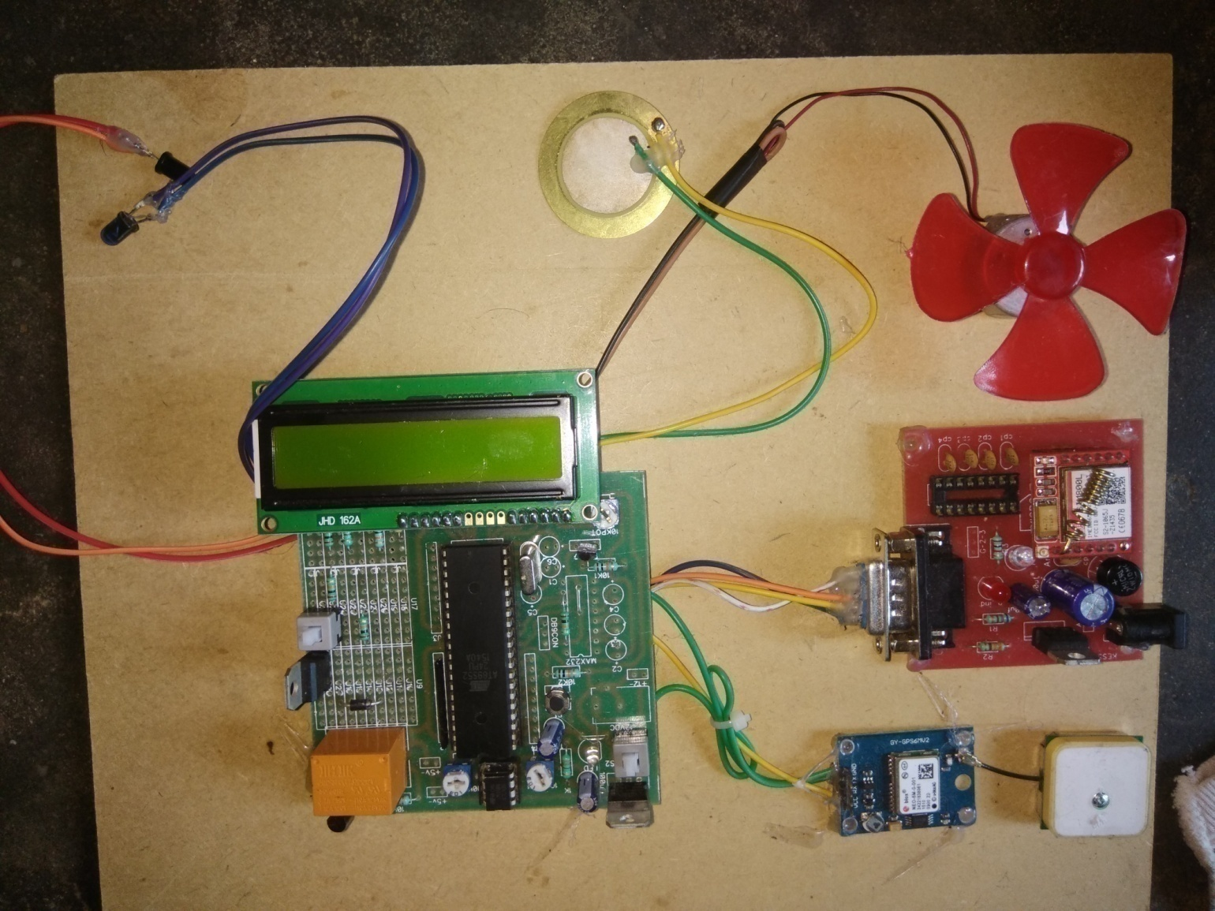
Circuit Connection

Slide 19
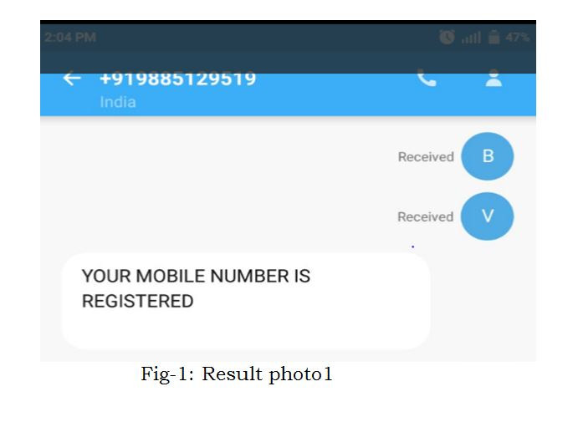
RESULTS

Slide 20
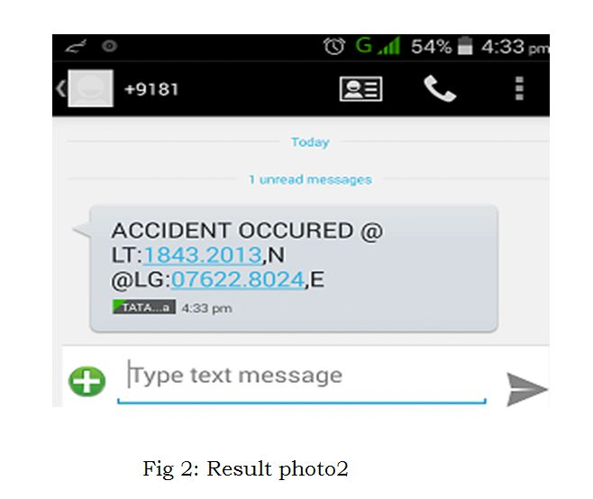

Slide 21
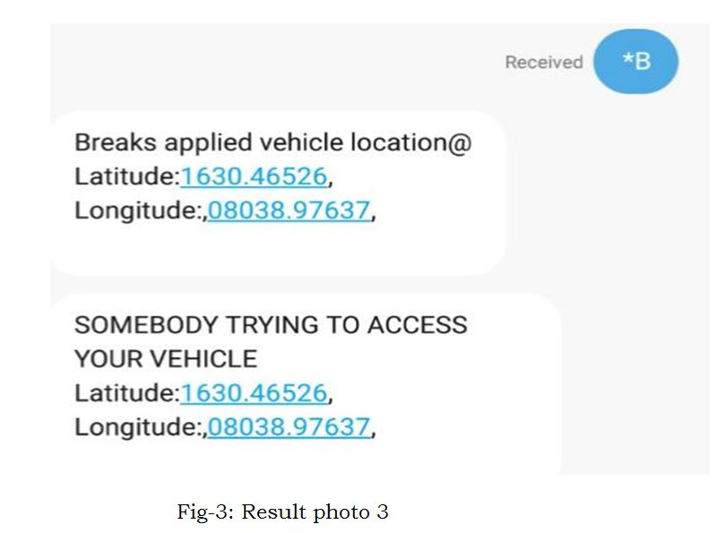

Slide 22
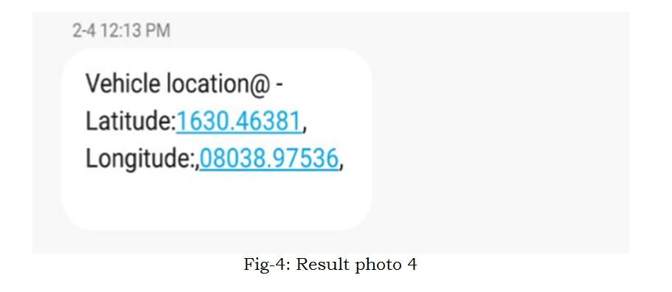

Slide 23
Applications
This project is applicable in following fields:
1. GPS Car theft detection can be used in transportation vehicles of Companies, schools, colleges and industries.
2. This project can be used in our cars and even in bikes.
3. VIP vehicle tracking
4. Can also be used for Child or animal tracking
5. Vehicle Security Applications

Slide 24
Advantages
1. The cost of implementation of the project was low
2. Better security will be provided for the vehicle
3. Tracking of the vehicle can be done easily
4. Remote communication using GSM modem from any where in world.
5. GPS based location Identification.
6. Sends location in the form of latitude and longitude.

Slide 25
Conclusion
Thus this project provide security, safety and tracking operations in a vehicle.
The vehicle tracking can be done at any anytime from any location.
Accident occurred in a vehicle was detected and notification was send as sms
This provides the security to vehicle using IR sensors
The vehicle is controlled from remote location.

Slide 26
Future scope
The project can be implemented with internet facility and More security can be provided further The project will be extended to work in remote locations when there were no signals to the GSM module

Slide 27
Refernences
1. Kevin King, S.W. Yoon, N.C. Perkins, K. Ajani, “Wireless MEMS inertial sensor system for golf swing dynamics”, Sensors and Actuators A:
Physical, vol.141,pg 2, 2008.
2.Jorge Salivary, Carlos T. Caliphate, Juan Carlos Cano,Pietro Manzoni” Providing Accident Detection in VehicularNetworks Through OBD-II
Devices and Android-based Smartphones” in 5th IEEE Workshop On User MObility and Vehicular Networks 2011 pp no : 978-1- 61284 928- 7
3. Md. Syedul Amin, Jubayer Jalil, M. B. I. Reaz “AccidentDetection and Reporting System using GPS, GPRS and GSM Technology” in
IEEE/OSA/IAPR International Conference on Informatics, Electronics &amp; Vision in 2012 pp no : 978-1- 4673-1154- 0/12.
3.R. Rathinakumar and D. Manivannan “Wireless AccidentInformation System Using GSM and GPS” in ResearchJournal of Applied Sciences,
Engineering and Technology 4(18): 3323-3326, 2012, ISSN: 2040-7467.

Slide 28
4. C.Vidya Lakshmi, J.R.Balakrishnan “Automatic Accident Detection via Embedded GSM message interface withSensor Technology” in
International Journal of Scientific and Research Publications,Volume2,Issue1.
5. N.Watthanawisuth,T.LomasandA.Tuantranont, ―Wireless Black Box Using MEMS Accelerometer and GPS Tracking for Accidental Monitoring
of Vehicles‖, Proceedings of the IEEE-EMBS International Conference on Biomedical and Health Informatics (BHI 2012) Hong Kong and
Shenzhen, China, 2-7 Jan 2012.
6. Chulhwa Hong, Truong Le, Kangsuk Chae, and Souhwan Jung. ―Evidence Collection from Car Black Boxes using Smartphone&#39;s‖. 2011
IEEE, Annual IEEE Consumer Communications and Networking Conference

Slide 29



